Slide 1
Vikram Voleti [09EE3501]
Summer 2012
Internship Presentation

Slide 2
MATLAB Codes
Original, Optimised, Efficient, User-friendly
Hidden Markov Models
Forward Algorithm
Backward Algorithm
Baum-Welch Algorithm
Viterbi Algorithm
Finger Tip Gesture Recognition

Slide 3
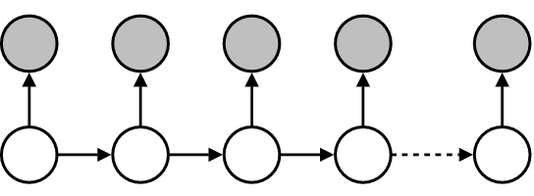
Hidden Markov Models
S₁ S₂ S₃ S₄ S_{n}
O₁ O₂ O₃ O₄ O_{n}

Slide 4
Hidden Markov Models
Pi : Nx1 matrix : Vector of initial probabilities of states,
a : NxN matrix : Probability of transition from state S_{i} to state S_{j},
b : NxM matrix : Probability of observing V_{k} for state S_{i},
Ob : Mx1 matrix : Vector of all possible observations,
O : EGxT matrix : Matrix of EG no. of 1xT dimensional observation sets,
Alpha : NxT matrix; Alpha(i,t) = Probability of observing partial observation sequence from start to time t, i.e. O₁,O₂,...,O_{t} , and being in state S_{i}, at time t,
Betaa : NxM matrix; Betaa(i, find(Ob==O(eg,t),1)) = Probability of partial observation sequence from t+1 to end, i.e. O_{t+1},…,O_{T}, given the state at time t was S_{i.}

Slide 5
Hidden Markov Models
Forward Algorithm
Backward Algorithm
Baum-Welch Algorithm
Viterbi Algorithm

Slide 6
Forward Algorithm
[Alpha, c, P] = ForwardAlgo(Pi, a, b, Ob, O)
Alpha(i,t) is the probability of observing partial observation sequence from start to time t, i.e., O₁,O₂,...,O_{t} , and being in state S_{i}, at time t
c is a Tx1 matrix, c(t) = Probability of the partial observation sequence till time t, and
P is an Nx1 matrix, P(n) = Probability of being in state S_{n} at the end time T.

Slide 7
Backward Algorithm
Betaa = BackwardAlgo(Pi, a, b, Ob, O)
Betaa(i, find(Ob==O(eg,t),1)) is the probability of observing the partial observation sequence from time t+1 to end, i.e. O_{t+1},…,O_{T}, given the state at time t was S_{i}

Slide 8
Baum-Welch Algorithm
[PiNew, aNew, bNew, AlphaNew, BetaNew, logProb, lP] = BaumWelsh(Pi, a, b, Ob, O, Alpha, Betaa, iters, maxIters, oldLogProb, lP);
Calculates new values of Pi, a and b.
Recursion
Employs Forward and Backward Algorithms

Slide 9
Viterbi Algorithm
Q = ViterbiAlgo(Pi, a, b, Ob, O)
Determines most probable State Sequence Q
S₁ S₂ S₃ S₄ S_{n}
O₁ O₂ O₃ O₄ O_{n}

Slide 10
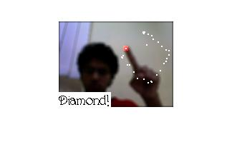
Finger-Tip Gesture Recognition
Finger-Tip Recognition
Skin-pixel Segmentation
First pixel from top
Finger-Tip Tracking
Store all finger-tip coordinates
Gesture Recognition using HMM’s
Use Viterbi Algorithm to determine most probable state sequence

Slide 11
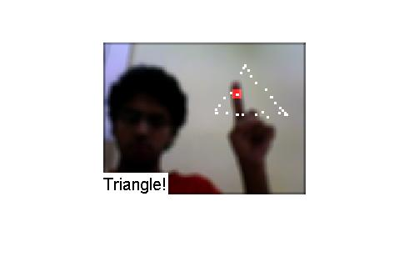
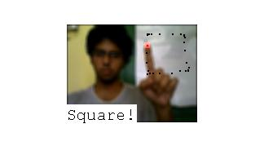
Finger-Tip Gesture Recognition

Slide 12
Finger-Tip Gesture Recognition
HMM 1: To determine the state among:
Right, Down, Left, Up, DR, DL, UL, UR
HMM 2: To determine the state among:
Triangle, Square, Diamond
Pi = [.4;
.03;
.03;
.04;
.4;
.03;
.03;
.04];
a = [.60 .25 .01 .01 .10 .01 .01 .01;
.01 .60 .25 .01 .10 .01 .01 .01;
.01 .01 .65 .15 .01 .01 .01 .15;
.01 .01 .01 .93 .01 .01 .01 .01;
.01 .01 .15 .01 .65 .15 .01 .01;
.01 .05 .05 .01 .01 0.6 .25 .01;
.01 .01 .055 .055 .01 .01 .60 .25;
.01 .01 .01 .01 .01 .01 .01 .93];
b(:,:,1) = [.10 .00 .90;
.34 .33 .33;
.10 .90 .00;
.34 .33 .33;
.10 .00 .90;
.10 .90 .00;
.10 .90 .00;
.10 .00 .90];
% for x coordinates
b(:,:,2) = [.34 .33 .33;
.10 .90 .00;
.34 .33 .33;
.10 .00 .90;
.10 .90 .00;
.10 .90 .00;
.10 .00 .90;
.10 .00 .90];
% for y coordinates
PI = [.34;
.33;
.33];
A = [.98 .01 .01;
.01 .98 .01;
.01 .01 .98];
B = [.09 .04 .25 .04 .25 .04 .04 .25;
.22 .22 .22 .22 .03 .03 .03 .03;
.03 .03 .03 .03 .22 .22 .22 .22];

Slide 13
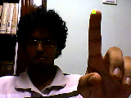
Finger-Tip Gesture Recognition

Slide 14
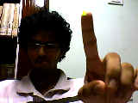
Finger-Tip Gesture Recognition

Slide 15
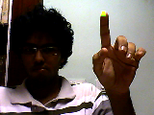
Finger-Tip Gesture Recognition

Slide 16
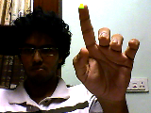
Finger-Tip Gesture Recognition

Slide 17
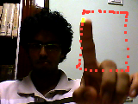
Finger-Tip Gesture Recognition

Slide 18
MATLAB Codes
Original, Optimised, Efficient, User-friendly
Hidden Markov Models
Forward Algorithm
Backward Algorithm
Baum-Welch Algorithm
Viterbi Algorithm
Finger Tip Gesture Recognition

Slide 19
Thank You.

